Slide 1
Effective Utilization of an External Control Arm in Oncology Drug Development
Antara Majumdar
Oncology Statistics, GSK

Slide 2
RCT as the Gold Standard
RCTs require a certain number of patients be enrolled in treatment and control arms
Learn from accumulated data
Accumulation of Clinical Trial Data and RWD over Time
Getting the objective number of patients to enroll in the control arm can pose ethical and/or operational challenges.
Notes:
RCTs have served as gold standard for evaluating new treatments against a placebo control or a standard of care. Over the years, that has lead to accumulation of large volumes of data on patients who received placebo control or standard of care under similar clinical and prognostic conditions. Which in turn, has presented us with the opportunity to collectively learn from accumulating data. And I am going to refer to that as historical clinical trial data.

Slide 3
What is an External Control Arm?
An External Control Arm (ECA) is an alternative to an active control arm in a clinical trial
ECA is constructed from individual patient-level data collected from sources outside of the current clinical trial
Built using external patients who meet the eligibility requirements of the target trial of interest
Balanced on baseline prognostic factors, disease characteristics, etc.

Slide 4
ECA Opportunities in Oncology Drug Development
Early clinical development go/no-go decisions
Accelerated approvals and breakthrough designations
Pediatric trials
Confirmatory single arm trials
Combination trials

Slide 5
Establish reasons for use of an ECA
Control arm drug is known to be stable over time – no temporal bias
No change in duration of chemotherapy over time
NCCN guideline recommends enrollment in a clinical trial
Recent RCTs have documented high drop-out rates in the control arm
Contemporary evidence of slow enrollment in the control arm in RCTs

Slide 6
Data Sources for ECA
Historical Clinical Trial Data
Real World Data
Data features:
Unknown data quality & missing data can be problematic
Non-standard endpoints can be constructed
Initial number of patients is large
Data features:
Regulatory quality is present by design
Endpoints are well-defined
Finding novel biomarker data can be challenging
External Control Arm (ECA)

Slide 7
Challenges for ECA use in Oncology
Consistency in endpoint definitions
Incompatible index date for OS and other time to event endpoints
Date of randomization does not exist in RWD, but available in historical clinical trials data
Treatment start date, date of last relapse are possible alternatives for index date
Difference in assessments for PFS
Adequate follow up time

Slide 8
Challenges for ECA use in Oncology
Availability of all required baseline characteristics
Prognostic biomarkers
Differing assay methods and cut-offs
Lab values
Prior treatment
Availability of safety data

Slide 9
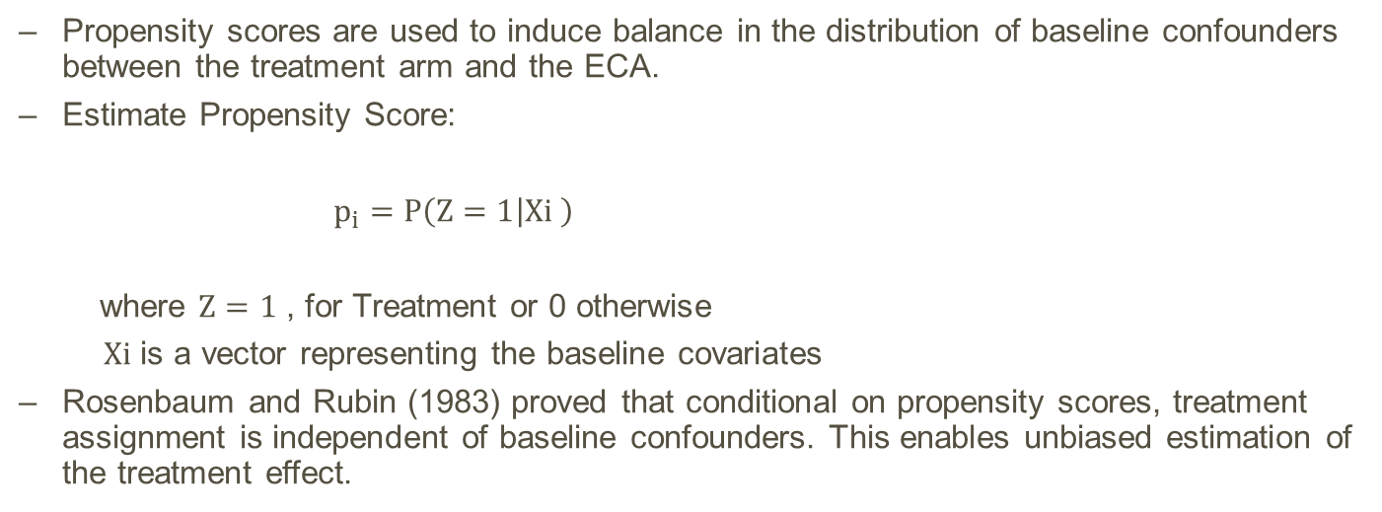
Propensity Score Based ECA
Propensity scores are used to induce balance in the distribution of baseline confounders between the treatment arm and the ECA.
Estimate Propensity Score:
$p_{i}=P\left(Z=1 | Xi \right)$
where $Z=1$ , for Treatment or 0 otherwise
$Xi$ is a vector representing the baseline covariates
Rosenbaum and Rubin (1983) proved that conditional on propensity scores, treatment assignment is independent of baseline confounders. This enables unbiased estimation of the treatment effect.

Slide 10
Propensity Score Based ECA
A desirable feature of the propensity score methods is that it enables separation of outcome from baseline balance, i.e., no outcome data is involved in inducing balance between treatment and control.
Matching
Propensity Scores
Weighting
Stratification

Slide 11
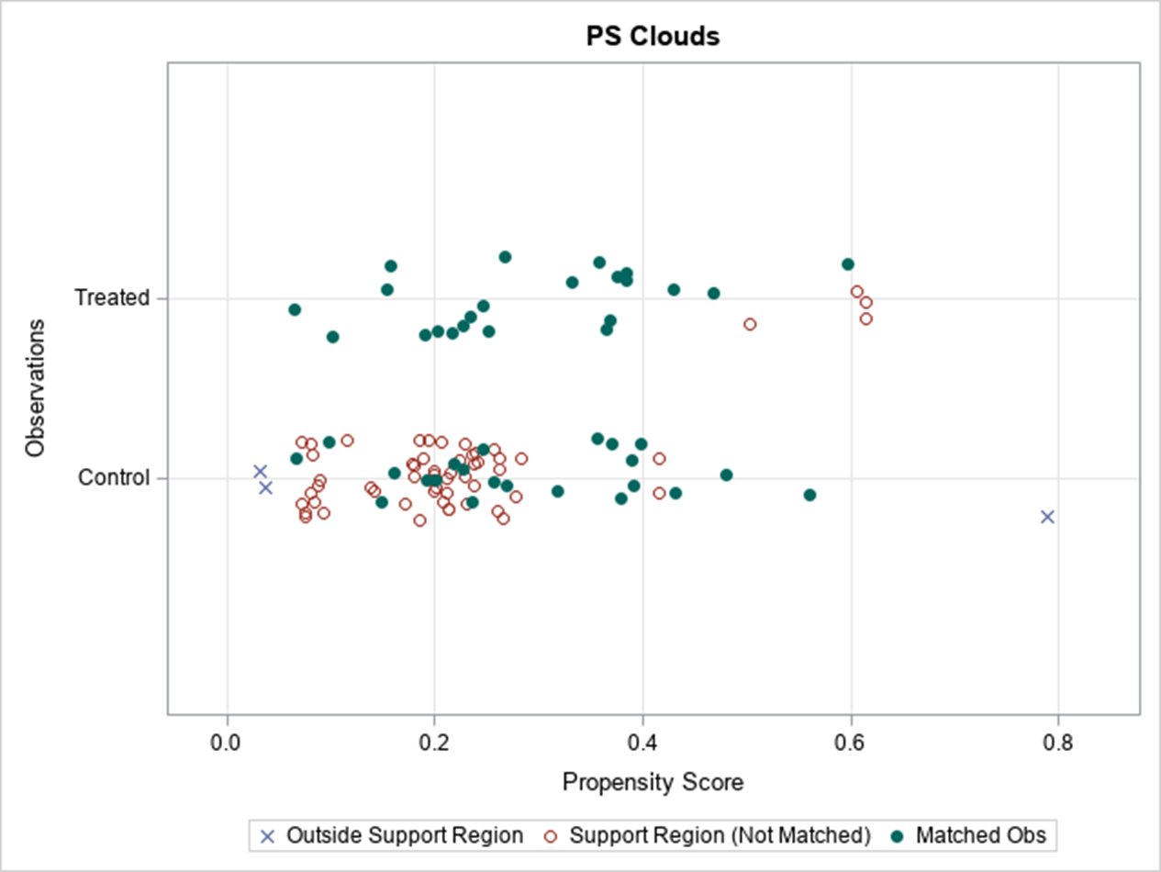
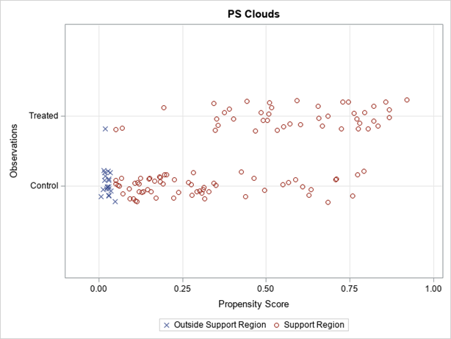
Example: Propensity scores matching and weighting
Trial A: 1-to-1 matching
Trial B: Weighting

Slide 12
Methodology: Frequentist ECA
Using propensity scores select external control patients on relevant baseline characteristics
Post-propensity score matching or weighting, perform outcome analysis adjusting for weights, if needed
Propensity score matching (1-to-1 greedy, full matching, optimal matching)
Inverse Probability of Treatment Weighting (IPTW)

Slide 13
Methodology: Bayesian ECA
Incorporate individual patient-level historical clinical trial data via construction of priors
Priors constructed using propensity score matched external control subjects
Post construction of prior, analyze outcome as usual using resulting posterior distribution
Pocock’s seminal paper (1976, J Chron Dis) first proposed Bayesian borrowing from historical clinical trials
Mixture priors, Power prior (Ibrahim and Chen, 2000, Stat Sci), Commensurate prior (Hobbs, Sargent and Carlin, 2011, Bayes Anal), Meta-Analytic-Predictive (Neuenschwander et al., 2010, Clinical Trials)

Slide 14
Down-weight Prior Information: Mixture prior
Today's prior is a mixture of yesterday’s posterior and a flat prior for p.
π(p| D) α f(D|p)× π_{mix}(p)
π_{mix}(p) ~ w* π_{H}(p) + (1-w)*Uniform(0,1)
Where,
D = Current Trial Data
π_{mix}(p) = Mixture prior from external control data
w = Mixing weight or P[Applicability of external data]
A convenient choice for w, will be to assign equal weight to each component.
Another approach is to choose a weight proportional to the sample size contribution of the external information.

Slide 15
Down-weight Prior Information: Power prior
Use external control data likelihood and a data discounting parameter for the external data, to construct a prior for the parameter, p.
π(p| D₀, a₀) α {[L(p; D₀)]^ a₀} × π₀(p)
where
L(p; D₀) = likelihood based on the external control data
a₀ = parameter to discount external control data; 0 ≤ a₀ ≤ 1
π₀(p) = initial prior for external control data

Slide 16
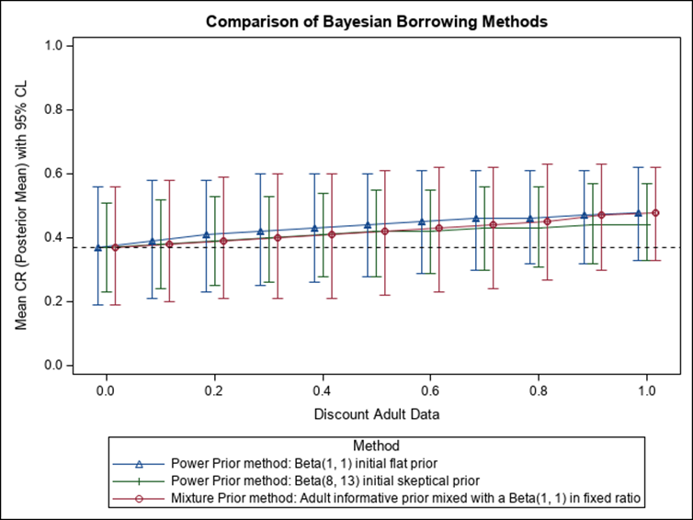
Discounted External Data

Slide 17
ECA based clinical development plan
ECA integration in a clinical study
Prospective study design
Clinical protocol and SAP
compare between the subjects in the target treatment arm and the ECA on IC/EC criteria, baseline covariates and endpoints definitions
Establish firewall for ECA data selection – select subjects while blinded to outcome
Balance diagnostics and sensitivity analysis
Briefing document
CSR

Slide 18
Lessons learned from regulatory interactions
Good quality external control data is the key!
Both historical clinical trials as well as medical chart review data or RWD acceptable – preference for the former
Provide side by side comparison of key eligibility criteria between target trial and external control data
Strong preference for simple statistical approaches driven by good quality, complete data
Frequentist and Bayesian methods – both acceptable
Preference for hybrid designs rather than full replacement – demonstrate numerical comparison between randomized controls and external patients
Get agreement on endpoint definition – index date is crucial

Slide 19
Lessons learned from regulatory interaction
Carefully select measurable confounders
Get agreement on a list of acceptable prognostic confounders
Adhere to strict cut-off for absolute standardized mean differences between the target treatment arm and the ECA

